Slide 1
On-Premise to Cloud Migration
Team Cloud: Andrew Bae, Jonathan Nguyen, Osman Choudhary, Yobell Woldu, & Nandu Rami

Slide 2
System Request
Project Sponsor: Chief Information Officer, Cloud and Infrastructure Department
Business Need: Move locally saved documents and processes to the cloud via Sharepoint, eliminating the problem of overwriting files, adding a check in and check out feature, and provide disaster recovery tools and methods

Slide 3
System Request- Cont.
Business Requirements: Provide cloud computing for users to access remotely and from different workstations. Aid in data management, data integrity and data loss prevention in event of a disaster (DR plan)
Business Value: Decrease time in reverting data loss, increase productivity and workflow, and reduction in on-premise server maintenance in both man hours and electricity

Slide 4
System Request - Cont.
Special Issues or Constraints: Although the bulk of the migration is happening in the Cloud and Infrastructure department, all employees’ help is needed to have a safe and effective data transition from local to cloud-based Sharepoint

Slide 5
Feasibility Analysis - Technical
Sharepoint is a tool used by many companies and is produced and maintained by Microsoft. Sharepoint provides an easy and straightforward way of moving data to the cloud.
Although users have not used Sharepoint yet, all of the Office suite products merge and work effortlessly thus reducing time of learning the product.
The project will require the C&I team, as well as the help of all employees’ to ensure an quick and effective migration

Slide 6
Feasibility Analysis - Economic
Costs: New servers, contracts and the downtime cost of data migration
Benefits: Reduced cost over time, up to date hardware and software, more space on-premise due to PaaS, proven for technology to move in this direction.
Viability: The project will cost money and not create revenue but will streamline the process of sharing, editing and working with files such as Excel spreadsheets and Word documents. The break-even point does not occur because at our current rate, we will be saving money year after year with the reduced cost of maintenance

Slide 7
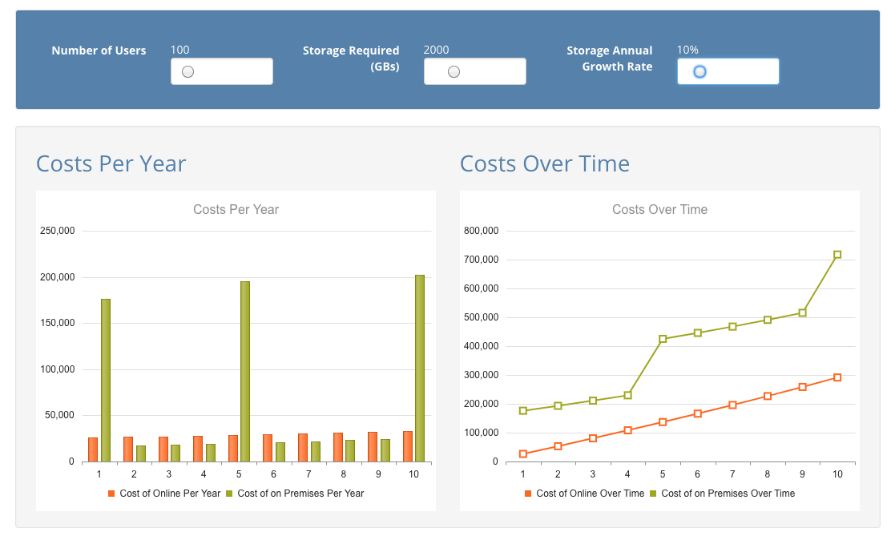

Slide 8
Feasibility Analysis - Organizational
Strategically, this is aligned with the company’s goal to retrofit the disaster recovery plan, increase employee productivity, and head towards cloud computing by means of PaaS.
There is no reason for users to be against this as it is a minor change in their day to day workflow but will pay off dividends when they need to access documents or prevents them from losing data due to data overwrite.

Slide 9
Project Methodology
We have chosen the V model project methodology for this project as this is a very hands on project for all members of the company.
Reasons:
Simple and straightforward
Allows for testing before product is live
Ample technical resources available with needed technical expertise from Microsoft

Slide 10
Work Plan
Phase | Task | Completion Period
Preparation | Data review | Week 1
 | Cloud preparation | Week 1-2
 | Data Collection | Week 2-3
Integration | Data input into Cloud | Week 3-4
 | Employee training | Week 4-8
 | Review | Week 9

